Slide 1
Case Study: How Does a Bike-Share Navigate Speedy Success?
By: Nikhil Deo

Slide 2
Project Introduction
In 2016, Cyclistic launched a successful bike-share offering. Since then, the program has grown to a fleet of 5,824 bicycles that are geotracked and locked into a network of 692 stations across Chicago. The bikes can be unlocked from one station and returned to any other station in the system anytime.
Until now, Cyclistic’s marketing strategy relied on building general awareness and appealing to broad consumer segments. One approach that helped make these things possible was the flexibility of its pricing plans: single-ride passes, full-day passes, and annual memberships. Customers who purchase single-ride or full-day passes are referred to as casual riders. Customers who purchase annual memberships are Cyclistic members
We have a clear goal: Design marketing strategies aimed at converting casual riders into annual members. In order to do that, however, the marketing analyst team needs to better understand how annual members and casual riders differ, why casual riders would buy a membership, and how digital media could affect their marketing tactics. Moreno and her team are interested in analyzing the Cyclistic historical bike trip data to identify trends.

Slide 3
Stage 1: Ask
How do annual members and casual riders use Cyclistic bikes differently?
Why would casual riders buy Cyclistic annual memberships?
How can Cyclistic use digital media to influence casual riders to become members?

Slide 4
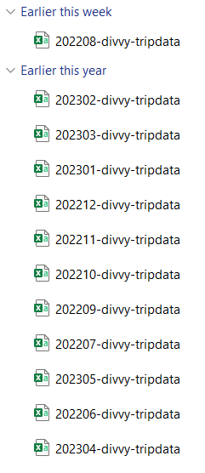
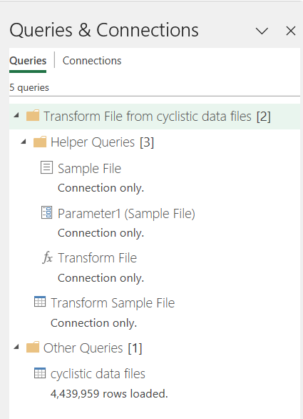
Prepare/Process
My data was available as 12 .csv files for each month. I encountered an error in which the file for 08/2022 had all the dates listed as a month earlier (July) .
After correcting the file, I was ready to import. I used power query to combine the files and loaded/stored the final file as a connection since the data was 4.4 million rows and a regular excel file only takes a little over 1M.
I also created new columns for trip duration and day of week while removing columns I wouldn’t need for the analysis.

Slide 5
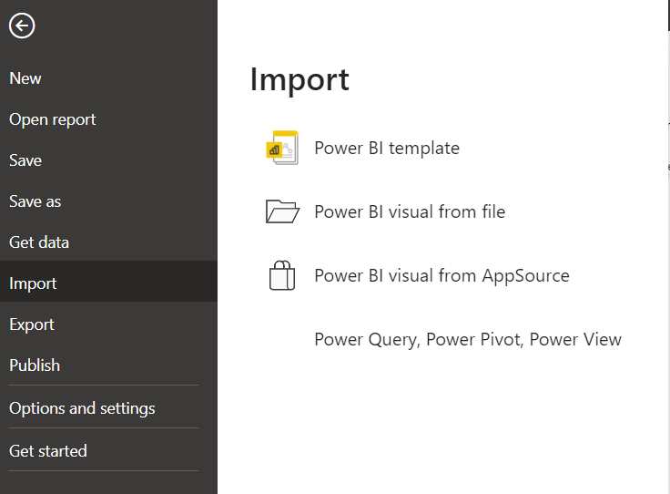
Prepare/Process
Now I had my data stored as a proper connection for reference whenever I needed.
I proceeded to load up Power BI (simpler for migration of data since I used Excel).
Problems encountered: the data type for the start_hour column was imported as text so I had to switch to the table/field view and change it to Time.

Slide 6
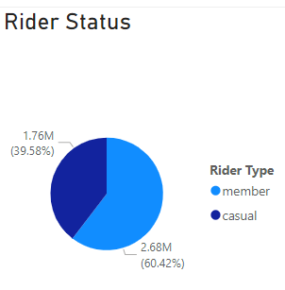
Visualizations: Rider Status
I started with a simple pie chart to see exactly how many riders were on some kind of membership plan.
60% of people who used the Cyclistic service in the last year were not on a membership plan regardless of their intended use, frequency of use, or destination.
Right away, I am inclined to surmise that due to this number being so large there will be multiple segments/target groups to market to each being a completely different offering and CTA.

Slide 7
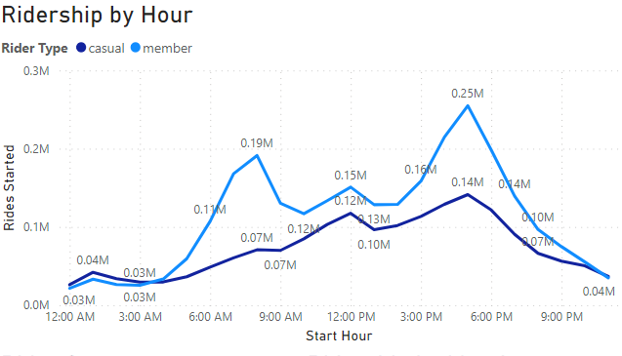
Visualizations: Ridership by Hour
Key Points:
Ridership for both members/non-members shows peaks at 8-9AM, a small uptick at 12PM (lunchtime) and again a sharp peak at 4-5PM, traditionally when work gets off.

Slide 8
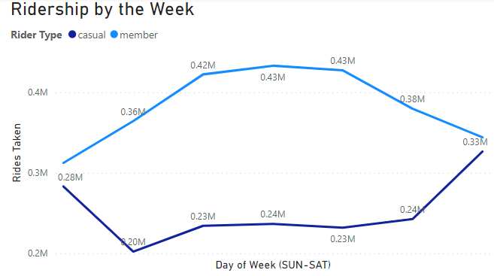
Visualizations: Ridership by Day of Week (SUN-SAT)
Key Points:
Ridership for members peaks during the week and sags off during the weekend. There is an inverse relation for non-members.
It may be assumed that a large portion of members find the bikes appealing for work transportation while non-members are using them for weekend leisure at almost the same rate as members.

Slide 9
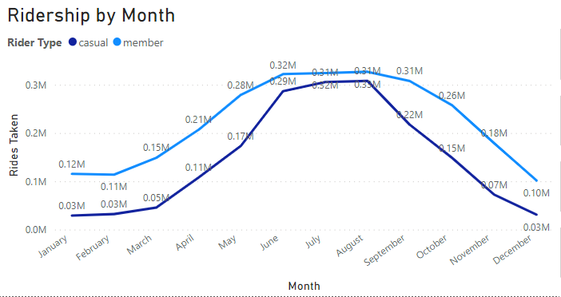
Visualizations: Ridership by Day of Week (SUN-SAT)
Key Points:
Across the board, both types of riders see upticks in the Spring months with peak ridership in Summer.
Ridership dies down again as Winter and Fall come around due to the colder temperatures and snow/ice.

Slide 10
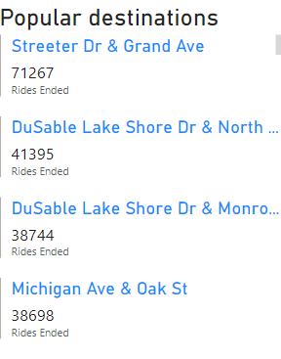
Visualizations: Ridership by Day of Week (SUN-SAT)
Key Points:
I also created a clickable list for further insights into ridership trends across months/week/days for each destination.
I have ordered the list in descending order by amount of rides ended at said station.
Based on which days, times, and rider type each station is being visited we can draw conclusions as to the reason people are riding there.

Slide 11
Conclusions
Based on ridership trends throughout the day, there is a market of working class, professional non-members taking the bikes to and from work as a main form of transportation. They need to be made aware of the cost-effective membership Cyclistic provides and have a clear value proposition in front of them to convert.
Weekend usage is very popular among non-members. To further this claim, we could investigate the clickable list to find the most popular spots for non-members and inspect what is in the area (malls, parks, restaurants, etc) to confirm this claim. We can also investigate the popular destinations for members and see what is around there as well (business district, office buildings, etc).
It would be worthwhile to start running Summer promotions a bit in advance due to the peaks in ridership during the hottest months. For non-working demographics (presumably school/college age persons who will use the bikes for entertainment) a student membership could be introduced to convert them.

